Slide 1
Chapter 6
Growth
Hans Rosling of Gapminder: 200 Years in 4 Minutes
http://www.gapminder.org/videos/200-years-that-changed-the-world-bbc/

Slide 2

Since Adam Smith’s famous book…
An Inquiry into the Nature and Causes of the Wealth of Nations
Economists have been trying to answer this question:
Why are rich countries rich and poor countries poor?

Slide 3
Growth in History
Up to ~500 years ago, most lived in conditions we would call abject poverty
Today: Income levels much higher and more diverse
Big minority of the world’s population has achieved rapid, sustained income growth
  Others, more modest->middle income
  Majority: in poverty (though usually better off than their ancestors)
What a difference a century makes (book)

Slide 4
Contrasting Growth Experiences

Slide 5
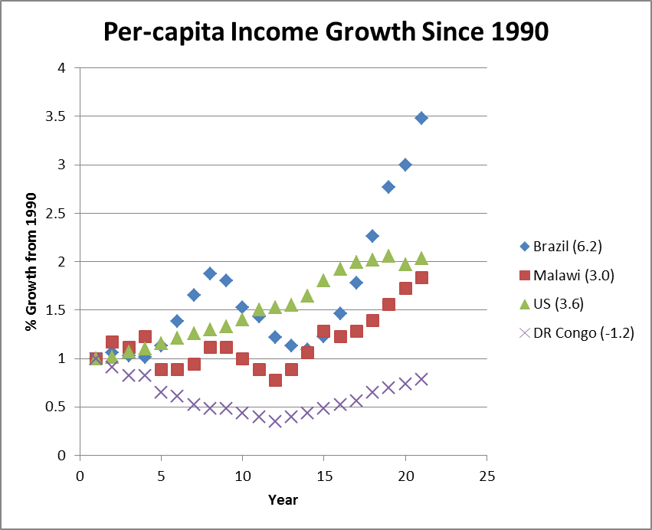
Why Do Some Countries Grow Faster Than Others?

Slide 6
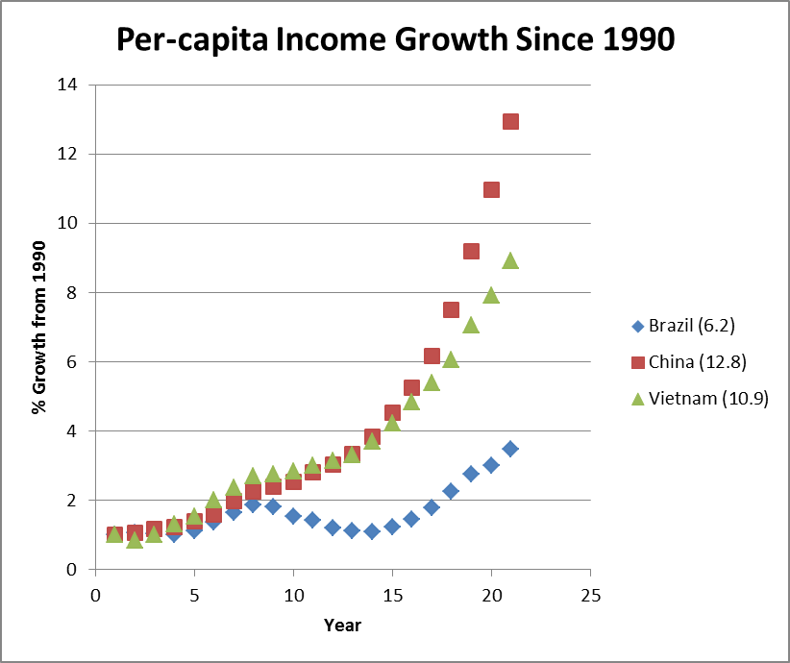
…And Some Grow Very Fast?

Slide 7
What Explains This? (The Quest for the Holy Grail of Growth)
Factor accumulation: Increasing size of the capital stock (or labor force)
  Machines, factories, buildings, roads, computers, etc.
Productivity growth: Increasing the amount of output produced by each machine or worker
  Use technologies you have more efficiently
  Technological change

Slide 8
Why We Need a Model
Because we’re human!
  Trying to recognize and interpret patterns in order to make sense of the world is a fundamental human impulse.
Useful to explore and understand the complexity of our world
Generate hypotheses we can test with data

Slide 9
Essentially, All Models Are Wrong, But Some Are Useful
-George Box, statistician

Slide 10
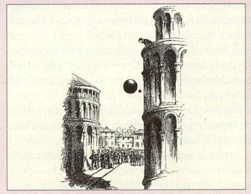
The Equation for Falling Objects
g = 9.8 m/s2 (gravitational constant)
In popular lore, Galileo Galilei (1564–1642) dramatically refuted Aristotle’s laws of motion by dropping unequal weights from the Leaning Tower of Pisa. In the scientist’s extensive writings, however, he never claimed to have conducted an experiment from that tower.
(http://www.endex.com/gf/buildings/ltpisa/ltpnews/1999/ltpsn121899.htm)

Slide 11

…assumes that you are in a vacuum!
Here's the famous footage of the Apollo 15 astronaut that dropped a hammer & feather on the moon to prove Galileo's theory that in the absence of atmosphere
http://www.youtube.com/watch?v=5C5_dOEyAfk

Slide 12



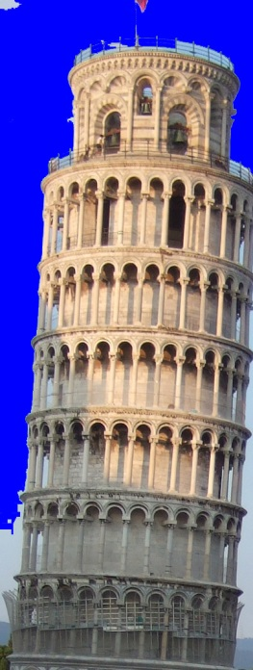

So Is It a Bad Model?
Not for a Hummer H2 dropped from the top of the Leaning Tower of Pisa (or a feather dropped on the moon)
Yes for a feather dropped on Earth (or a Hummer H2 dropped from a high-flying jet)

Slide 13
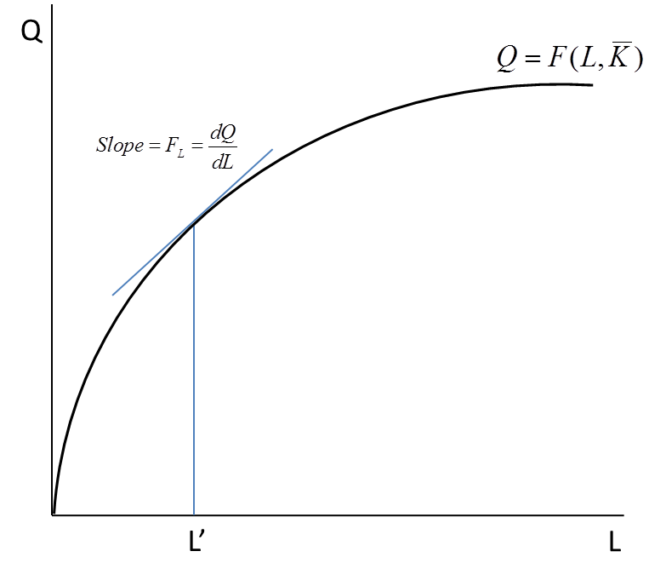
Starting Point: How Does Income (GDP) Get Produced?
By combining labor (L) and capital (K)
Technology described by an Aggregate Production Function:

Slide 14
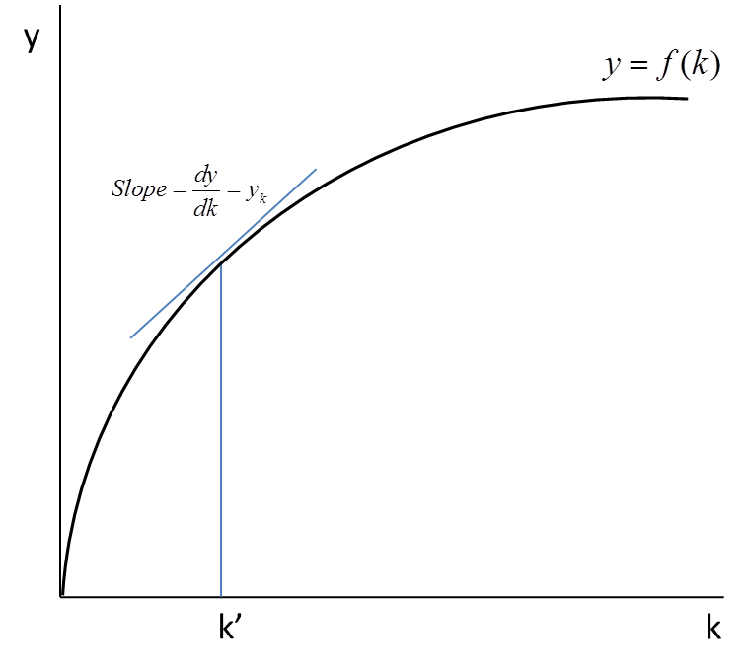
Constant Returns to Scale

Slide 15
What Explains Capital/worker in an Economy?
The amount of investment per worker
  Creates capital
The population growth rate
  Adds workers and dilutes the amount of capital per worker
The capital depreciation rate (how quickly capital wears out during the production process)
  steadily erodes the capital stock
  economies have to keep investing in new capital just to stay in the same place – like on a treatmill!

Slide 16
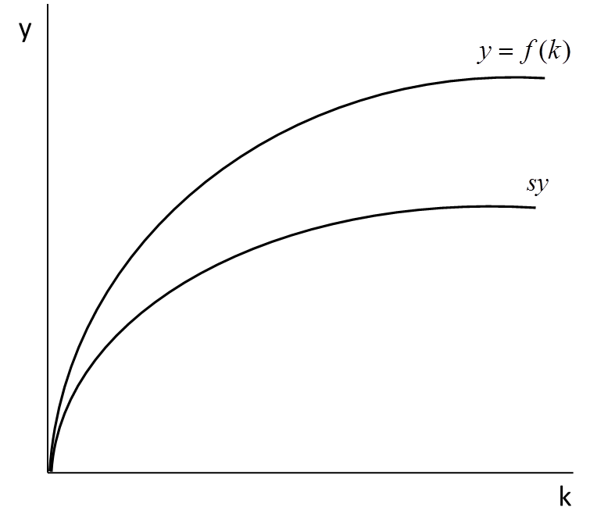
Savings Per Worker (sy)
(s = the savings rate)
No capital, no savings, no income!

Slide 17
Change in Capital Per Worker

Slide 18
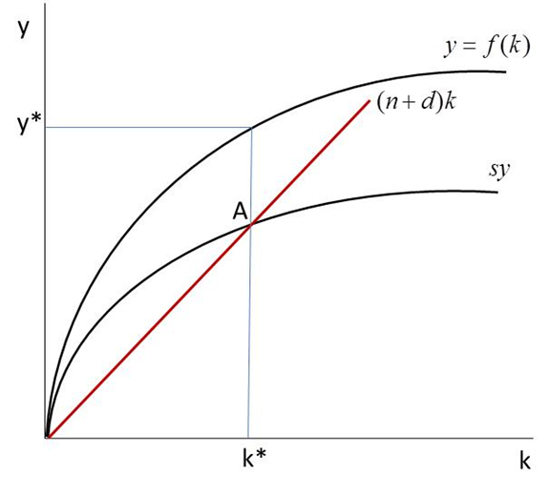
Put It All Together:
The Solow Diagram
Point A: Steady state, long run, or potential output per worker
Steady State: Where Δk=0

Slide 19
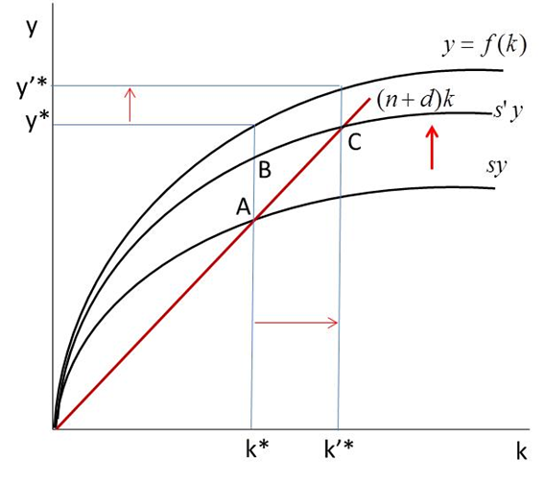
A Higher Savings Rate (s’>s) Raises K and Income/Worker

Slide 20
A Higher Savings Rate (s’>s) Raises K and Income/Worker

Slide 21
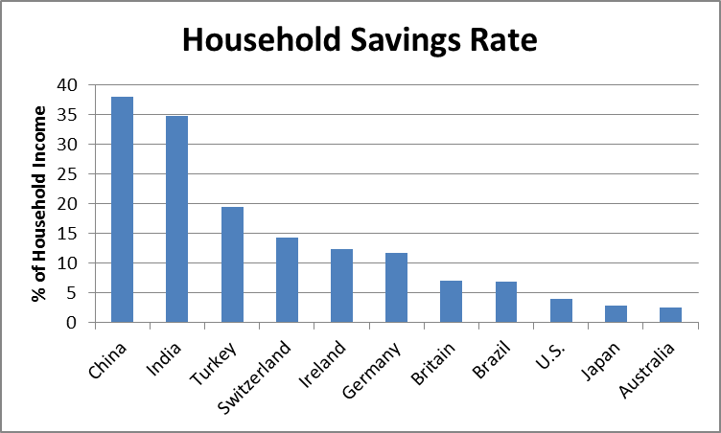
Can the Savings Rate Be Too High?
Chinese people older than 50 save more than 60 percent of their income. They remember the “bitter years:”
- the Great Famine (1958 to 1961)
- violence of the Cultural Revolution (1966 to 1976)
One young Chinese man said: “Maybe I’m too busy to have a lot of time spending money.”
Source Data: OECD, World Bank, Standard Chartered, Turkish State Planning Office, British Office for National Statistics
http://www.businessweek.com/printer/articles/46918-how-household-savings-stack-up-in-asia-the-west-and-latin-america
Keith B. Richburg, “Getting Chinese to stop saving and start spending is a hard sell.” The Washington Post, 7/5/2012,
http://www.washingtonpost.com/world/asia_pacific/getting-chinese-to-stop-saving-and-start-spending-is-a-hard-sell/2012/07/04/gJQAc7P6OW_story.html

Slide 22
Explaining Household Savings http://www.businessweek.com/printer/articles/46918-how-household-savings-stack-up-in-asia-the-west-and-latin-america
China: 38%
  No national safety net
India: 34.7%
  India's savings rate has been building along with the acceleration of its GDP growth
Turkey: 19.5%
  Turkish savings, high by U.S. standards, are not enough for a developing country
Switzerland: 14.3%
  The Swiss vie with Swedes and Austrians to be the top savers in the West
Ireland: 12.3%
  The Irish savings rate quadrupled over two years in response to the financial crisis
Britain: 7%
  British savings have declined sharply since the early 1990s
Brazil: 6.8%
  Latin American economies generally have low savings rates
U.S.: 3.9%
  U.S. savings are up from a 1.7% low but far below a postwar average of 7% or so
Japan: 2.8%
  The savings decline in Japan from 15% in 1992 is the most dramatic in the industrialized world
Austraila: 2.5%
  The Australians, like the Americans, have had a huge housing boom compensating for the loss in savings

Slide 23
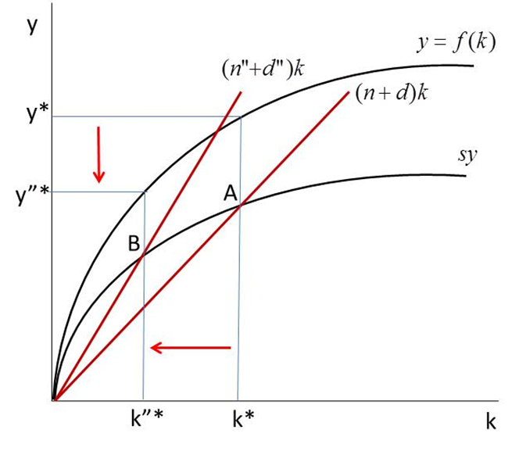
Higher Population Growth or Depreciation Do the Opposite

Slide 24
Higher Population Growth or Depreciation Do the Opposite

Slide 25
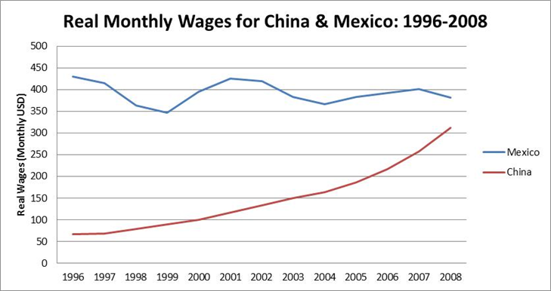
Some Testable Implications of the Solow Model
√ Big success stories have growing capital per worker
  China, Asian Tigers confirm this
  Higher k means higher productivity, wages

Slide 26
You Always Come Back to the Steady State
? Shocks can throw economies off their steady state—but they eventually return
  See the bombing Vietnam box
  Berkeley and Oakland after the ’91 fire
  New Orleans after Katrina?

Slide 27
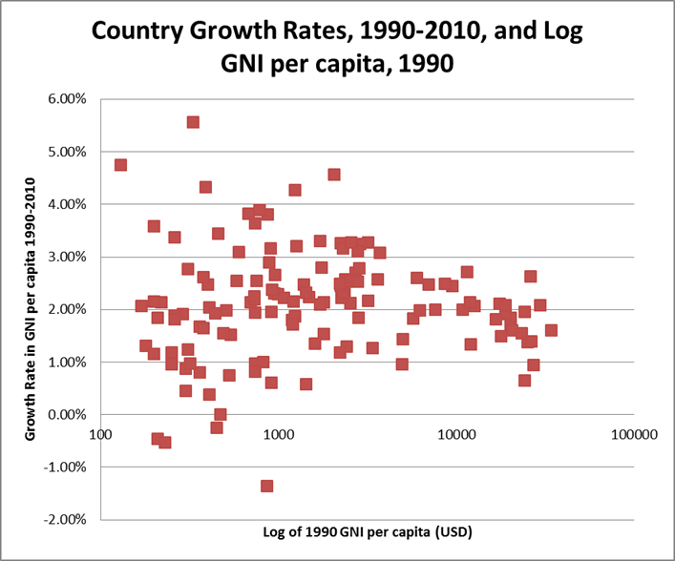
The Convergence Hypothesis
Given s and n, countries’ incomes should converge. Lower income, higher growth?
Are poor countries growing faster than rich ones?
(Hard to see a pattern here)

Slide 28
There Isn’t Even Convergence Within Countries!
See Hans Rosling’s video
Shanghai is like Italy
Rural Guanzhou is like Ghana
Oaxaca vs. Mexico City
US South vs. the rest
The “Farmworker Towns” of California’s San Joaquin Valley
  …with per-capita income less than Mexico’s!

Slide 29

Growth in aggregate income should be explained by growth in labor and capital.
Is it?
“I Just Ran Two Million Regressions.”
Xavier X. Sala-I-Martin, American Economic Review 87(2): 178-83, 1987.

Slide 30
Things Explaining Growth
Capital investment
Political rights
Openness to trade
Black markets
Colonial legacy
War
Religion
…to name a few

Slide 31
The Biggest Question of All
What explains the production function?
  That’s where technological change is
Henry Ford, the internet, and my teeth
Concentration of technological change in rich countries keeps convergence from happening (increasing returns to scale)

Slide 32
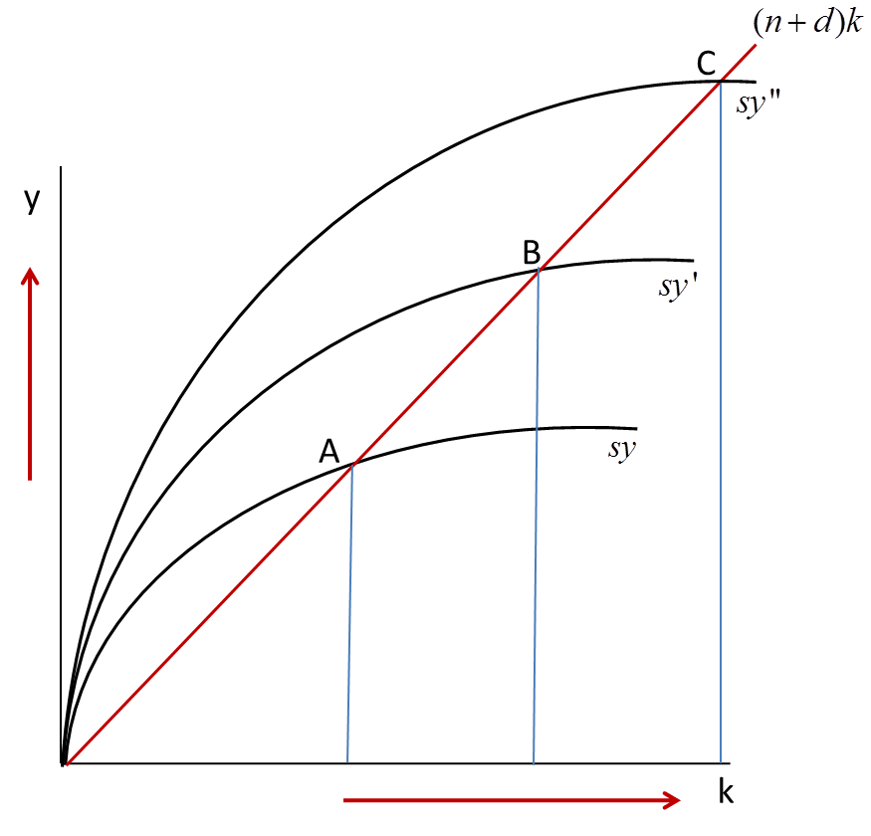
Exogenous Technological Change in the Solow Model

Slide 33
Exogenous Technological Change in the Solow Model

Slide 34
The Gazillion Dollar Question: What Makes Technological Change Happen?

Slide 35
Each unit of capital investment not only increases the stock of physical capital but also increases the level of the technology for all firms in the economy through knowledge spillovers
-Paul Romer, economist, entrepreneur, activist

Slide 36
Object Gaps and Idea Gaps
Object Gap: “Nations are poor because they lack valuable objects like factories, roads, and raw materials.”
Idea Gap: Nations are poor because their citizens do not have access to the ideas that are used in industrial nations to generate economic value.”
  Closing the idea gap requires interaction and communication with the rest of the world

Slide 37
Endogenous Growth
S
Keys to Increasing Returns to Scale
Technological change (new f(k))
Spillover effects
Agglomeration effects

Slide 38
From Solow to Endogenous (“New”) Growth Models
Key difference: Increasing Returns to Scale: Doubling inputs more than doubles output. How?
Positive externalities:
  Effect of my education on yours
  Spread of new ideas (e.g., Ford’s assembly line; “spillovers”)
  R&D Investments -> new knowledge benefiting everyone
    The internet
  Growth perpetuates itself through technological change
Facebook: 0 to $100 billion in 9 years
  Google: 0 to $343 billion in 13 years
  What country’s production looks like Google’s?

Slide 39
  Does this apply to LDCs?
    Japan (in the late 1900s), Korea, India (Bangalore), now China (?)
      Making the jump from off-shoring to innovating
    Will Mexico manage to do it? (They’re trying!)
    What about the rest of the world? Zimbabwe?
      They can grow rapidly by adapting technologies developed in countries with high R&D capability
      Hard to imagine them becoming tech or manufacturing giants in our lifetimes
Does a country have to innovate to develop?

Slide 40
A Different Kind of Steady State: The Poverty Trap
(from Chapter 3)
45°
Recursion function graph
B
A_{t+1}> A_{t}
A_{t+1} (Assets next year)
A
A_{t+1}< A_{t}
‘Rolling marbles’ profile
0
A_{t} (Assets this year)
A_{t} (Assets this year)
Poverty trap

Slide 41
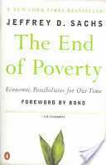
What’s the Answer, Then?
Jeffrey Sachs: The Big Push
The millennium villages: Development with massive aid

Slide 42
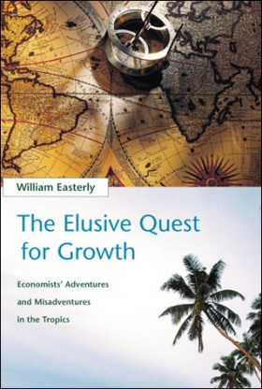
Counterpoint: William Easterly
Getting incentives right
Aid can be bad
Who do you agree with? (Check out videos)

Slide 43
Supplemental Reading
Institutions

Slide 44
What Are Institutions?
Operating systems for societies and economies
  Platform of rules, conventions, norms, and processes
  Affect how we make decisions, how our decisions affect others, and how all these decisions and interactions work together to create markets and the broader society.
  Often function in the background of our lives and go underappreciated—that is, until they get buggy and crash.

Slide 45
Examples of Institutions
Concrete: Banks (financial institutions), institutions of higher learning (UCD), mental institutions, the military
Not-so-concrete: Democratic institutions, codes of dress, modes of greeting people, symbolic communication systems such as spoken language.
  Social conventions and institutions do not specify what “is done”, but rather what “ought to be done.”
  Zoologists: animal institutions in the wild

Slide 46
Corruption Is an Institution
Bends the rules of the game in favor of some people to the detriment of others – and to society as a whole.
Creates serious obstacles to economic development
  Diverts the energy of clever people into corrupt instead of productive pursuits
  Turns laws and law enforcement into opportunities for personal gain instead of broader social benefit.

Slide 47
Point: Institutions Matter Big Time
Inclusive Institutions
  Political systems that are pluralistic, protect individual rights, and create the conditions that reward innovation and entrepreneurship, including secure private property and competitive markets
Extractive Institutions:
  Concentrated political power and economic institutions that reinforce and often enrich the powerful few.
    Like mining: Gold mining extracts but does not create gold
Daron Acemoglu (MIT) and James Robinson (Harvard), Why Nations Fail (2012)

Slide 48
Why Nations Fail
Acemoglu & Robinson (2012)
Differences in economic and political institutions are the dominant explanation for why some countries are rich and others poor
Institutions can be a potent economic force because of the positive or negative dynamics they trigger
Elites may not want things to improve, since genuine improvements may deteriorate their power.

Slide 49
Counterpoint: Institutions Aren’t Everything
(Jeffrey Sachs)
Authoritarian elites aren’t necessarily hostile to economic progress
The diffusion of technology from other countries sometimes matters more than innovation
Even if we could magically transform institutions, unfavorable geography and other factors may continue to constrain growth and development
(If Sachs isn’t right about this, do millennium villages make sense?)

Slide 50

World Bank president calls corruption 'Public Enemy No. 1'
WASHINGTON Thu Dec 19, 2013 1:49pm EST

Slide 51
Institutions Matter, But How Much?
Hard because of the reflection problem (Ch.11)
  Institutions shape economic development
  Economic development enables countries to invest in stronger institutions (like better law enforcement).
  It’s a chicken-and-egg problem.

Slide 52
The Reflection Problem
The treatment (“good” institutions) and the outcome you want to measure (development) move together
  Institutions shape economic development
  Economic development enables countries to invest in stronger institutions (like better law enforcement).
Like a Hall of Mirrors: How can you separate the bad guy (the treatment) from his reflections (the outcome)?
  Some pistachio nuts could help…
  They are an “instrument”

Slide 53
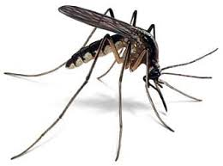
An Instrument for Institutions: Malaria?
If Europeans could live in a place without a constant threat of tropical diseases or other hazards, they tended to import more inclusive institutions
If mortality risks kept Europeans from settling en masse in a location, they opted for more extractive institutions
“Settler mortality risk” as instrument for extractive institutions?
Daron Acemoglu (MIT) and James Robinson (Harvard), Why Nations Fail (2012)

Slide 54
So Where Do Institutions Come From?
William Easterly: Top-down vs. bottom-up
The top down view: institutions are created by leaders and legislators who govern and establish laws.
The bottom up view: institutions emerge and constantly evolve
  …based on the social norms, traditions, values & beliefs of individuals as they interact and exchange with each other in a society
  laws are codified and accepted after (because) they seem reasonable & useful to people

Slide 55
Why Does It Matter?
Top down: Leaders and legislators can determine a society’s institutional path
  Including revolutionary do-overs
Bottom up: Institutions only change gradually, as individuals change their values or beliefs.
  Astute leaders and legislators formalize these institutions into laws and regulations
  Institutions are “evolutionary rather than revolutionary.”

Slide 56
What It Means for Us
Top down view: Experts are needed to help craft and refine institutions
Bottom up view: Little room for experts to engineer institutions to solve social or economic problems
  …and woe to the leader who tries to change institutions, if people aren’t ready to change!

Slide 57
A Middle Road
Institutions govern individual behavior and social interaction in profound ways – and they exist for specific reasons
Still may be room to impose institutions from the top down in the form of laws and regulations
  …but must appreciate the richness & complexity of pre-existing norms, values, beliefs
Societies evolve different institutions even in the long run
  Wit: China’s unique mix of political and economic institutions

Slide 58
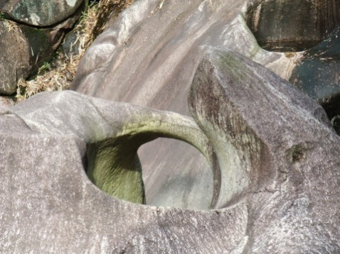
水滴石穿 — Shuĭ Dī Shí Chuān
(Water Drops Pierce Stone)

Slide 59
"Without effective institutions, poor people and poor countries are excluded from the benefits of markets."
World Bank Chief Economist and Senior Vice President Nicholas Stern

Slide 60
Boxes
How Market Institutions Make It Tough to Do Business in Sub-Saharan Africa
Do Land Rights Make People More Productive?

Slide 61
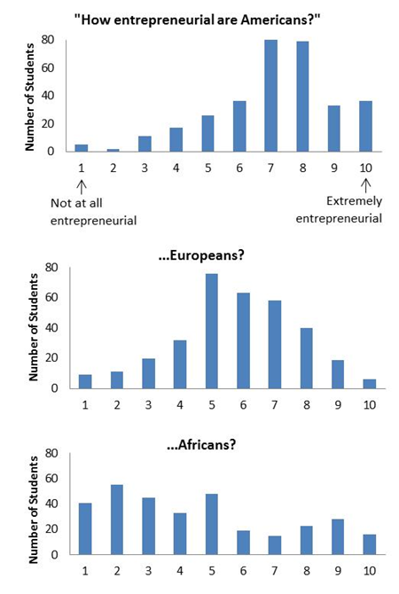
How Entrepreneurial Are We?
Institutions determine “where the money is (Willie Sutton)” in a society and thereby channel the entrepreneurial capacity of a people
Rent seeking vs. productive pursuits?
Responses of undergraduates at UC Davis to the question, “How entrepreneurial are ____?”

